Slide 1


Add a Slide Title - 1

Slide 2
Darkness Lesson 8 Overcoming the Disappointments of Life

Slide 3

The Devil’s Great Deception
One of the greatest draws of the modern day “Health and Wealth Gospel” or “Prosperity Gospel” is the belief the disciple of Jesus will go through this life enjoying all of the blessings available without experiencing the many disappointments that are also possible. “
You are blessed and highly favored by God, and no child of God will go wanting in this life!” is the favorite mantra of those who might buy into such teachings.
In fact, Leroy Thompson was once quoted as having proclaimed, “God said: ‘It is time to tell the money you don’t belong to the wicked you belong to us!’”
He would go on to say and even author a book focusing on the idea of, “Money come to me now!”
Whether it be money, health, or any other blessing imaginable, those who prescribe to this type of teaching go all in and expect their fortunes to turn in their favor.
They plan to no longer experience the disappointments (sadness or displeasure that is caused by one’s hopes and expectations not being realized) of life that have for years weighed upon their shoulders. Who could blame them for at least giving it a shot?

Slide 4


The Devil’s Great Deception
For the person who has already experienced many of life’s disappointments, this type of hope offered by the “Prosperity Gospel” is too good to pass up.
Who would not jump at the opportunity to live a life where only blessings are enjoyed while the disappointments are in the rearview mirror?
Unfortunately, those who fall for the lies of the “Prosperity Gospel” are left in a place that surely must seem even worse than where they were to begin with.
They go into this faith exercise expecting for the disappointments of life to be a thing of the past, but they quickly realize they are just as susceptible to difficulties as they were before.

Slide 5
The Devil’s Great Deception
Worst off are those who respond to the continuance of life’s challenges by assigning blame to God as if He were the One who caused us to experience such difficulties!
Those people who presumably throw themselves at the mercy of God in faith and fail to achieve a higher level of fortune are now jaded towards God because they see Him as being a liar. T
he false teachings they have been fed through the false Gospel of health, wealth, and prosperity leave them with a completely distorted view of God’s promises to His people.
Instead of realizing the eternal blessings that come through Christ, these people are left wanting only those temporal and earthly blessings that were so strongly promised to them by the health, wealth, and prosperity teachers.
The good influence the pure Gospel of Jesus might have had earlier in their lives is now greatly hindered by the false Gospel.

Slide 6
The Devil’s Great Deception
And yet, that is exactly what the great Deceiver has set out to do!
Satan, “the father of lies” (John 8:44), knows a distorted view of God and His promises is a highly effective tool in keeping people from possessing a true measure of saving faith.
In fact, is that not what the serpent did in the very beginning with Adam and Eve in Genesis 3? Did he not seek to distort Eve’s understanding of what God desired for the crown jewel of His creation?
God had simply said, “From any tree of the garden you may eat freely; but from the tree of the knowledge of good and evil you shall not eat, for in the day that you eat from it you will surely die” (Gen 2:17).
God only wanted what was best for Adam and Eve. He did not want them to die!

Slide 7


The Devil’s Great Deception
However, it does not take long for there to be an attempted distortion of God’s will for humankind.
In Genesis 3, we find the serpent testing the understanding of Eve concerning God’s commandments for her and her husband. “Indeed, has God said, ‘You shall not eat from any tree of the garden?’” (Gen 3:1)
Of course, this is not what God had told Adam and Eve, and Eve was well aware of this.
She showed this understanding by simply restating in Genesis 3:2 what is originally recorded for us in Genesis 2:17. Y
et, the serpent is not willing to drop this discussion. Instead, we see him seeking to distort Eve’s understanding of what God had said by saying, “You surely will not die!
For God knows that in the day you eat from it your eyes will be opened, and you will be like God, knowing good and evil” (Gen 3:4-5).

Slide 8
The Devil’s Great Deception
Do you see what he did there?
The serpent sought to pit Eve against God by saying God’s motives were purely selfish!
According to the serpent, not only would Eve not die, but she would actually be improved and elevated to a lofty position like God!
Surely the serpent was setting disappointment in the heart of Eve by leading her to believe God did not truly wanting what was best for her and her husband.
How could a loving God keep something so great from His favored creation?!
Therefore, it should not surprise us. This distorted view of God’s will for man in the Garden of Eden leads Eve to the point of disobedience to God when she sees the tempting nature of the fruit and succumbs by taking of it, giving some to her husband, and eating it together with him.
It is at this point true disappointment is realized not just by Eve and her husband, but God also feels it because of the failures of the man and his wife.

Slide 9
The Devil’s Great Deception
God’s disappointment was quickly followed by punishment because of Adam and his wife’s sin.
Expulsion from the garden (Gen 3:21-24) and the introduction of difficulties in living a life on earth (Gen 3:16-19) only led to further disappointments for the first man and woman and the many generations that were to follow even up until our current day. T
he disappointments we experience in life were not God’s desire for us. But they are a natural consequence of the presence of sin in this world because of our unwillingness to submit faithfully to the will of God in all things.
Yes, Adam and Eve were the first to experience disappointment in this life, but they are far from the last examples found within Scripture.

Slide 10
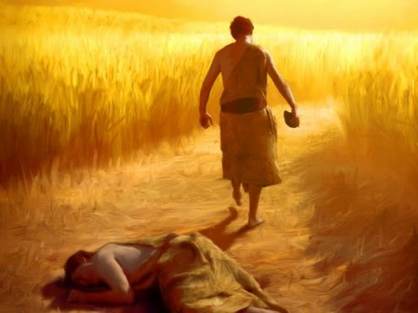
Biblical Examples of Disappointments: Cain
Quickly following the happenings in the Garden of Eden, we find Cain experiencing disappointment because the heavenly Father did not hold Cain’s sacrifice in high esteem.
The text says, “but for Cain and for his offering He had no regard. So, Cain became very angry, and his countenance fell.” (Gen 4:5)
Did you catch the end of that verse? “His countenance fell.”
Cain was experiencing the disappointment that comes when hopes and expectations are met.
We know Cain’s reaction led him down a very dark road that ended with the murder of his own brother.

Slide 11
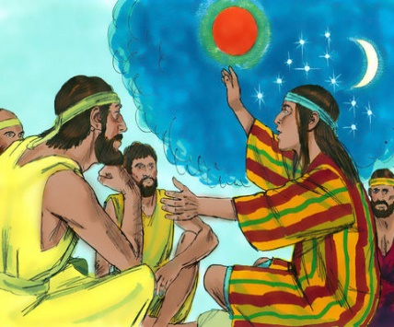
Biblical Examples of Disappointments: Joseph
Joseph surely would have never imagined his brothers would hate him to the degree that they would fake his death and sell him off to a band of Midianites, but that is precisely what we read happening in Genesis 27:18-36.
His disappointments are only compounded when he finds himself in Egypt as a slave.
Sure, he eventually found himself in a high position within Potiphar’s house, but then comes the wicked actions of Potiphar’s wife that leads to Joseph’s wrongful imprisonment (Gen 39:6-20).
Joseph interpreted a dream for the chief cupbearer which led to the cupbearer release from prison. All Joseph requested in return was that the cupbearer remember Joseph when things went well, but Genesis 40:23 tells us the cupbearer failed to remember Joseph’s kindness.
Joseph’s life was full of disappointments.

Slide 12
Biblical Examples of Disappointments: Moses
While Moses was the strong leader God needed to guide His people toward and into the promised land, Moses’s own personal journey ends short of the promised land.
During the forty years of wilderness wanderings, we find the people in great need of water, and God seeks to provide for their needs just as He had always done.
The solution for this water shortage was for Moses to go up to the rock of Horeb where he was to strike the rock. Moses obeyed the Lord, and from the rock poured forth water that refreshed the children of Israel (Gen 17:1-7).
Later on in Numbers 20, God commanded him to speak to the rock. Unfortunately, Moses lost his composure with the people and did not hold God sacred, and he struck the rock. Water did come pouring forth from it.
This act of disobedience aroused God’s anger, and His punishment was swift and severe. "Because you have not believed Me, to treat Me as holy in the sight of the sons of Israel, therefore you shall not bring this assembly into the land which I have given them” (Num 20:12). For Moses, this must have been devastating! He had long labored with these stubborn and cantankerous people, and yet he would not enjoy the overflowing milk and honey of the promised land. What disappointment for this godly man and leader!

Slide 13
Biblical Examples of Disappointments: David
David faced disappointment in his life. Though he had given around seven years of his life in service to King Saul, David was hated by his king because of the wicked heart that had developed within Saul.
This most certainly weighed heavily on the heart of David as Saul pursued David for around four years.
David truly only wanted the best for God’s chosen king and people (I Sam 21-31).
The disappointments within David’s life didn’t end with the troubles he experienced concerning Saul. S
adly, we know David made grave mistakes that brought upon heart-breaking consequences. No error was greater than what we see in 2 Samuel 11 & 12 involving Bathsheba, Uriah, and the baby that would eventually die.
Yes, David, a man after God’s own heart (Acts 13:22), still experienced tremendous disappointments throughout his life.

Slide 14
Biblical Examples of Disappointments: Jesus
There are numerous other biblical examples of people who struggled with the disappointments they faced in life.
We should also consider our Lord Jesus.
Our Lord was willing to leave the perfect home of heaven in order to take on flesh (Phil 2:5-8), and His willingness to do such a thing only opened Him up to the possibilities of experiencing the many disappointments of this life.
Sure, Jesus must have been constantly disappointed and discouraged by the Jewish leader’s hard-heartedness of His day.
All the more disappointing must have been the lack of faith, trust, and spiritual maturity shown by His closest disciples from time to time. Whether it be their arguing over who would be the greatest (Luke 22:23-27), Peter’s overconfidence (Luke 22:28-34), or Peter’s betrayal (Luke 22:55-62), Jesus’ expectations of His disciples were not always realized.
How disappointing, frustrating, and even discouraging that must have been!

Slide 15
Our Disappointments
If all of these biblical figures (especially Jesus) could experience disappointments in their own lives, then surely we must be aware such things can affect us, as well.
Yes, hundreds and even thousands of years have passed since the events recorded in the Bible, yet disappointments still exist because their causes still exist.
We might be living in a world that looks vastly different from the world of biblical times, but its inner workings are still basically the same.
Disappointments continue to occur because we as people continue to experience loss, and we continue to be exposed to sin.

Slide 16
Our Disappointments
Think back to Adam and Eve, Cain, Joseph, Moses, David, and Jesus.
Which of these individuals did not experience great loss within their own lives?
Adam and Eve lost their perfect unstained purity.
Cain lost the life he knew among his own family.
Joseph lost his freedom and identity.
Moses lost out on experiencing the promised land.
David lost years of happiness and a son.
Jesus would eventually give His life in an excruciatingly painful manner.
Every one of these biblical figures knew what it felt like to lose something precious to them.
Except for Jesus, sin was the cause.

Slide 17
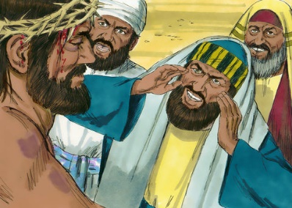
Our Disappointments
Of course, there was no sin on the part of Jesus, but his death was a direct result of the hatred that was directed towards him by the Jewish leaders.
On top of that, Jesus only needed to come to this world to die because of the sins of humankind and to fulfill our need for a perfect redeeming sacrifice.
At some point in the loss of each of these examples, we find sin at the root.
This is significant for us to understand when it comes to coming to grips about the disappointments we experience in life.

Slide 18
Our Disappointments
All loss and disappointment is NOT a direct result of our own sin or the sins of someone associated with us.
The preacher of Ecclesiastes reminds us that sometimes in life, things just happen. “I again saw under the sun that the race is not to the swift and the battle is not to the warriors, and neither is bread to the wise nor wealth to the discerning nor favor to men of ability; for time and chance overtake them all. Moreover, man does not know his time: like fish caught in a treacherous net and birds trapped in a snare, so the sons of men are ensnared at an evil time when it suddenly falls on them” (Eccl 9:11-12).
Sometimes bad things just happen because we live in a broken world!

Slide 19
Our Disappointments
Regardless of why loss and disappointments happen, the reality is it does, and we must learn how to deal with it.
If we only direct our efforts towards the prevention of disappointments, then we will eventually realize our endeavors to be in vain.
Even if we rid ourselves of sin within our own lives, we still live in this old broken world that will leave us disappointed in one way or another.
Therefore, consider how it is we can learn to deal with the disappointments we face in this life.
If prevention is not worthwhile, then what can we do to handle the disappointment we might as well expect to come our way?

Slide 20
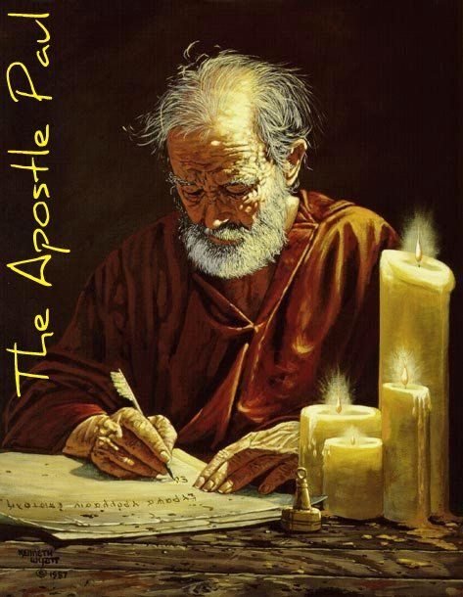
The Chief of Disappointments: Paul
There is one particular man we have not mentioned up to this point who experienced his fair share of disappointments and discouragements in this life, the Apostle Paul.
Those who have spent even just a little time within the New Testament letters are surely aware of the difficulties the Apostle Paul went through during his ministry of the Gospel of Jesus Christ.

Slide 21

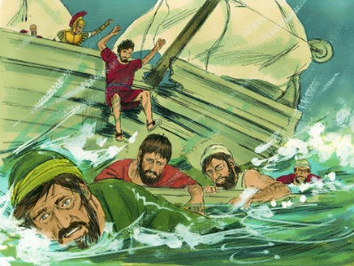
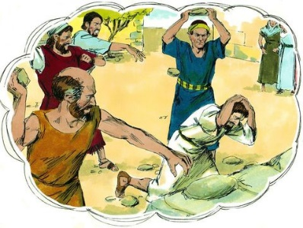
The Chief of Disappointments
“…in far more labors, in far more imprisonments, beaten times without number, often in danger of death. Five times I received from the Jews thirty-nine lashes. Three times I was beaten with rods, once I was stoned, three times I was shipwrecked, a night and a day I have spent in the deep. I have been on frequent journeys, in dangers from rivers, dangers from robbers, dangers from my countrymen, dangers from the Gentiles, dangers in the city, dangers in the wilderness, dangers on the sea, dangers among false brethren; I have been in labor and hardship, through many sleepless nights, in hunger and thirst, often without food, in cold and exposure.Apart from such external things, there is the daily pressure on me of concern for all the churches” (2 Corinthians 11:23-28).

Slide 22
The Chief of Disappointments
Yes, Paul found forgiveness in Jesus, but that did not erase his past in the sense that it never happened.
Paul’s history was still very much a reality.
Could you imagine being the Apostle Paul and going into the homes of friends or relatives of the very people you had imprisoned or cast your vote to have killed because they were Christians?
How much guilt, pain, and disappointment must Paul have felt because of his past actions?
And yet, we find the Apostle Paul fully embracing the grace and mercy of Jesus.
Paul was willing to allow his past mistakes to serve as an example so others might be more fully convinced of Jesus’s patience being present within their own lives.

Slide 23
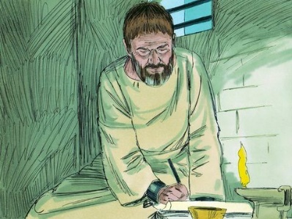
The Chief of Disappointments: Paul
The key to Paul’s ability to overcome the disappointments of life is surely evident, is it not? It all had to do with Jesus!
Paul had fully committed his life to Jesus. He had come to Jesus as a man who was, as Jesus had previously said, “weary and heavy ladened,” and he had truly found rest from his past in Jesus (Matt 11:28).
Yet, how had he found this rest in Jesus? How was he able to leave the past behind?
How was he willing and able to keep the major disappointments of life from destroying him? I believe the answer to this question is found in Philippians 3.

Slide 24
Paul’s Triumphs Over Disappointments
The letter that Paul wrote to the Philippians was a letter that clearly centered around efforts to encourage some brethren who Paul would say had experienced, “the same conflict which you saw in me” (Phil 1:30).
They had their own opponents (Phil 1:28), and Paul wanted them to know they could overcome the difficulties they were facing that surely caused them to be disappointed and discouraged.
Paul uses his own life, attitude, and mindset to encourage these brethren to follow his example and the example of others who were mature in their faiths (Phil 3:15-17).
What was the attitude and mindset that helped Paul to overcome?

Slide 25

Paul’s Triumphs Over Disappointments
In Philippians 3:1, we find Paul reminding the brethren that this letter was meant to be a safeguard as a means of encouragement because there were going to be dogs and evil workers of the false circumcision who were going to continue to trouble them in their faiths.
He reminds them they were of the true circumcision that is found in Christ (Col 2:9-14), and their confidence was not to be in the flesh.

Slide 26
Paul’s Triumphs Over Disappointments
However, if anyone could put their confidence in the flesh, then it would be Paul. “Although I myself might have confidence even in the flesh. If anyone else has a mind to put confidence in the flesh, I far more: circumcised the eighth day, of the nation of Israel, of the tribe of Benjamin, a Hebrew of Hebrews; as to the Law, a Pharisee; as to zeal, a persecutor of the church; as to the righteousness which is in the Law, found blameless” (Phil 3:4-6).
Paul had every right to put enormous confidence in this fleshly and worldly accomplishments. But instead, he was willing to “count all things to be loss in the view of the surpassing value of knowing Christ Jesus my Lord, for whom I have suffered the loss of all things, and count them but rubbish so that I may gain Christ” (Phil 3:8).
Paul’s worldly experiences, both positive and negative, were of no value to him because he only valued what he had in Jesus Christ. He was politely stating it was nothing but dung or excrement in his eyes. That is how strongly Paul felt about his past!

Slide 27
Paul’s Triumphs Over Disappointments
Paul would go on to say he had but one purpose and focus.
The focus was to continue to “press on” (Phil 3:12) and constantly be “reaching forward” (Phil 3:13), so he might achieve the goal and be able to lay his hands on the ultimate prize (Phil 3:14).
We cannot forget that Paul’s eyes were always looking to Jesus. No matter what his past mistake. No matter what his past disappointments. No matter his past discouragements. No matter what he might be going through, Paul kept his eyes on Jesus and the goal of being like Him in everything he did.
He knew this intense focus on Jesus would allow him to overcome whatever this life might throw at him whether those be things in his past, things in his present circumstances (by the way, Paul was in prison as he wrote this letter), or things that would come.
Paul recognized his citizenship was residing in heaven (Phil 3:20), and he had eyes only on achieving the goal.

Slide 28
Paul’s Triumphs Over Disappointments
Paul’s words in 2 Corinthians 5:1-10 quite nicely sum up the totality of what Paul was trying to get across to the Philippians. “For we know that if the earthly tent which is our house is torn down, we have a building from God, a house not made with hands, eternal in the heavens. For indeed in this house we groan, longing to be clothed with our dwelling from heaven, inasmuch as we, having put it on, will not be found naked. For indeed while we are in this tent, we groan, being burdened, because we do not want to be unclothed but to be clothed, so that what is mortal will be swallowed up by life. Now He who prepared us for this very purpose is God, who gave us the Spirit as a pledge. Therefore, being always of good courage, and knowing that while we are at home in the body we are absent from the Lord— for we walk by faith, not by sight— we are of good courage, I say, and prefer rather to be absent from the body and to be at home with the Lord. Therefore we also have as our ambition, whether at home or absent, to be pleasing to Him. For we must all appear before the judgment seat of Christ, so that each one may be recompensed for his deeds in the body, according to what he has done, whether good or bad.”
He wanted the focus on that which was eternal and not that which was temporal.
Paul’s earthly existence was tough. However, Paul was willing to endure such things because he truly desired to experience the blessings at the feet of Jesus in heaven. He was willing to endure whatever disappointments this life threw at him so long as he could experience eternal glory forever with his God in heaven. He knew there was a “crown of righteousness” (2 Tim 4:8) waiting for him beyond this life!

Slide 29

Conclusion
We will only be kidding ourselves if we fail to recognize the severity of the sufferings of Paul.
We just fool ourselves if we fail to acknowledge the disappointments he faced in his life as a disciple and Apostle of Jesus Christ.
We only hurt ourselves when we fail to consider his example so that we might be strengthened and encouraged to overcome the disappointments and discouragements we face in our own lives.

Slide 30

Conclusion
Adam, Eve, Cain, Joseph, Moses, our Lord Jesus, and many other biblical characters found themselves facing disappointments.
Regardless, we have seen that our circumstances do not have to lead us down paths of hopelessness and despair.
Satan would surely love for this to be our end, but through the grace and mercy of Jesus our Lord we can still attain the victory in this race of life by keeping our focus on the goal of being like Jesus so we might obtain the prize of eternal glory with our Heavenly Father.
May he bless us and strengthen us as we strive to overcome the devil’s dark distortions and run this race in such a way that we might win!

